Slide 1
Emotion Recognition in Videos Through Deep Neural Network Models
By: Koushik Roy

Slide 2
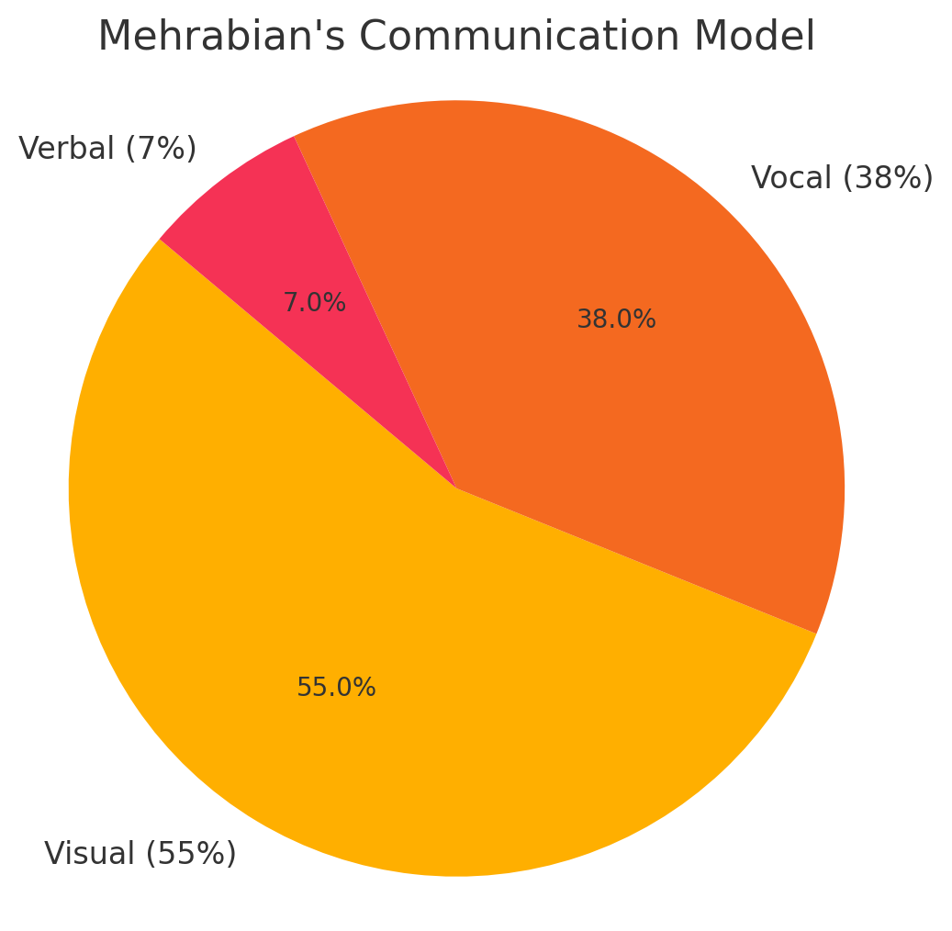
Why Emotion Recognition
Emotion is vital in social and human-robot interaction
Study: 55% visual, 38% vocal, 7% verbal
Facial cues (e.g., smile, brow movement) = key indicators
Challenge: Emotion recognition in videos

Slide 3
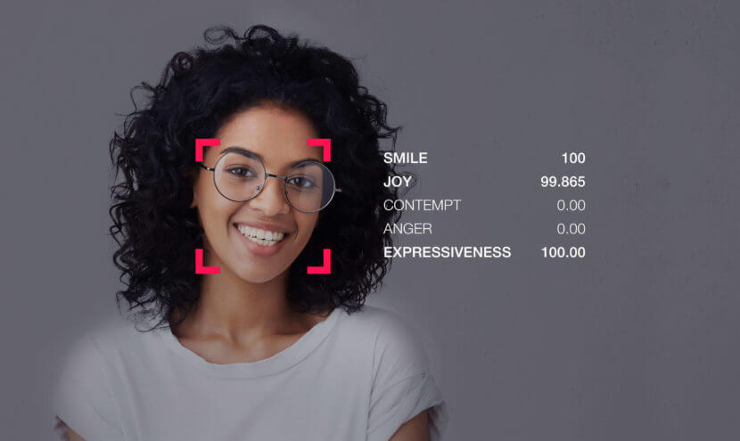
Problem Statement
Input: 4D tensor from video: T (frames) × C (channels) × H × W
Output: Predicted emotion class (e.g., happy, sad, etc.)
Goal: Test deep learning models to improve accuracy
Focus: Visual features only

Slide 4
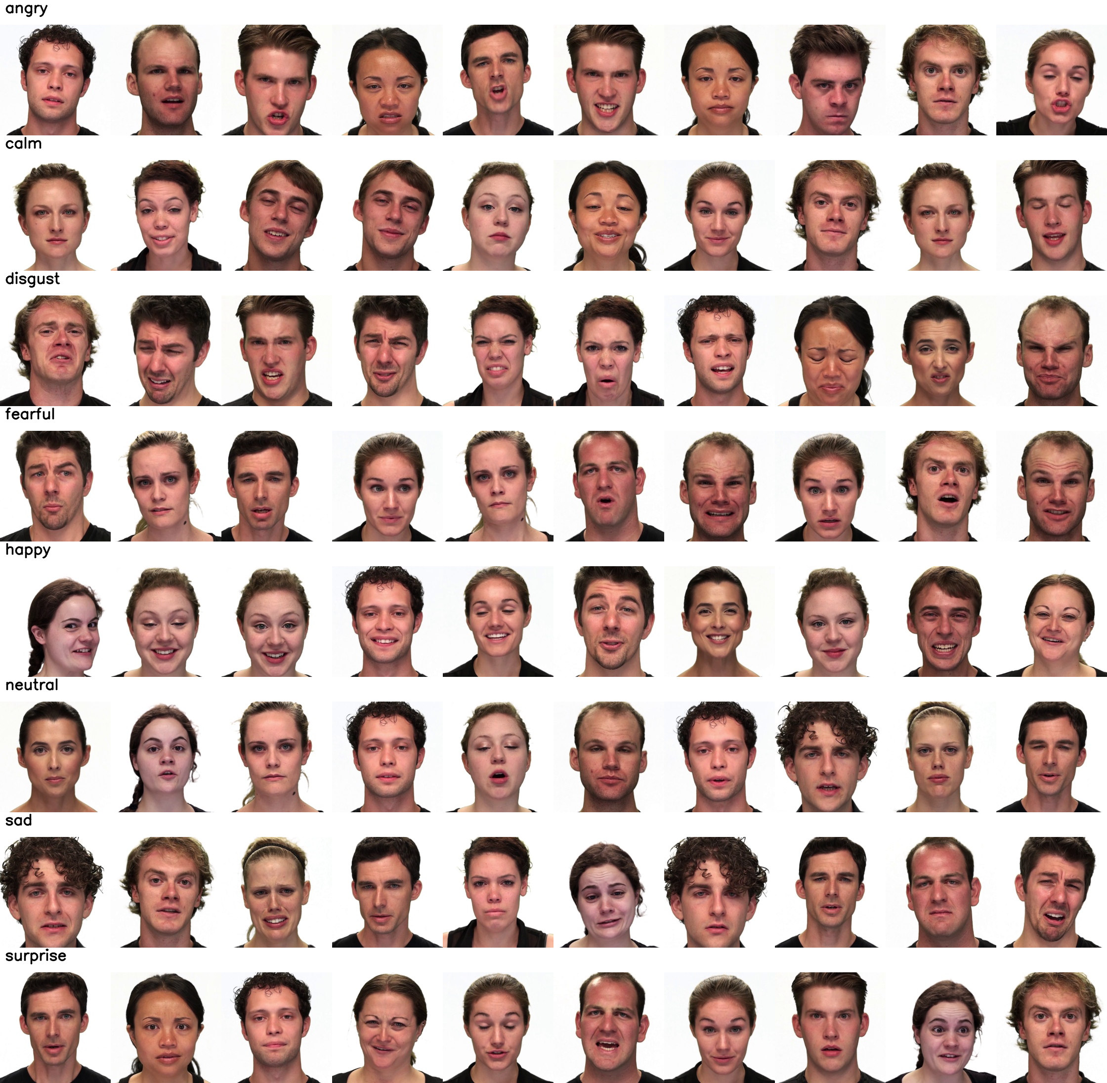
Dataset Overview
Ryerson Audio-Visual Database of Emotional Speech and Song
Emotions (8): calm, happy, sad, angry, fearful, surprise, disgust, neutral
Each emotions has 2 emotional intensity: Normal and Strong
Except for Neutral, it has just one emotional intensity. That’s why the number of samples are half of the other emptions.

Slide 5
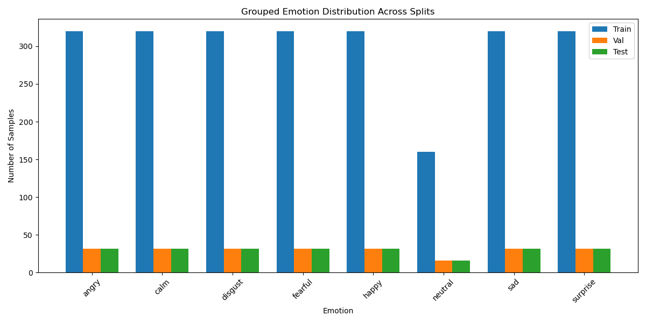
Dataset Stats
1,400+ clips, 24 actors, 1280×720 resolution
Train/Val/Test split: 80/10/10
For Train we have 320 samples per emotion (except for neutral which has half 160)
Total Train Samples = 320*7 + 160 = 2400
For Validation and Test we have 32 samples per emotion (neutral has 16) and 240 in total each split

Slide 6
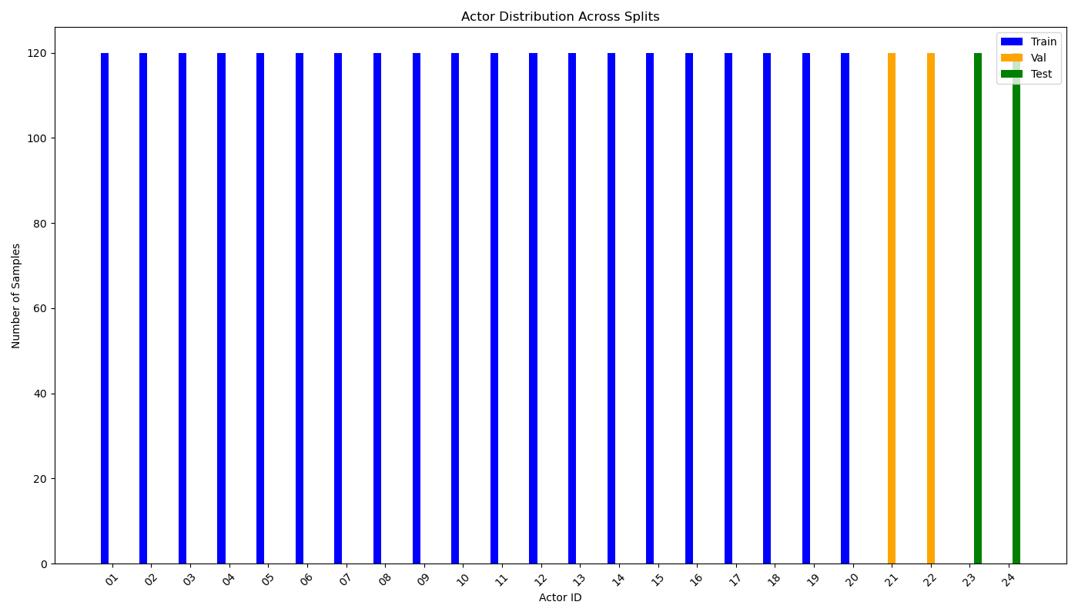
Dataset Stats
1,400+ clips, 24 actors, 1280×720 resolution
Train/Val/Test split: 80/10/10
Train: Actor 1 – 20
Val: Actor 21, 22
Test: Actor 23, 24
Odd: Male, Even: Female
Per actor 120 Samples

Slide 7
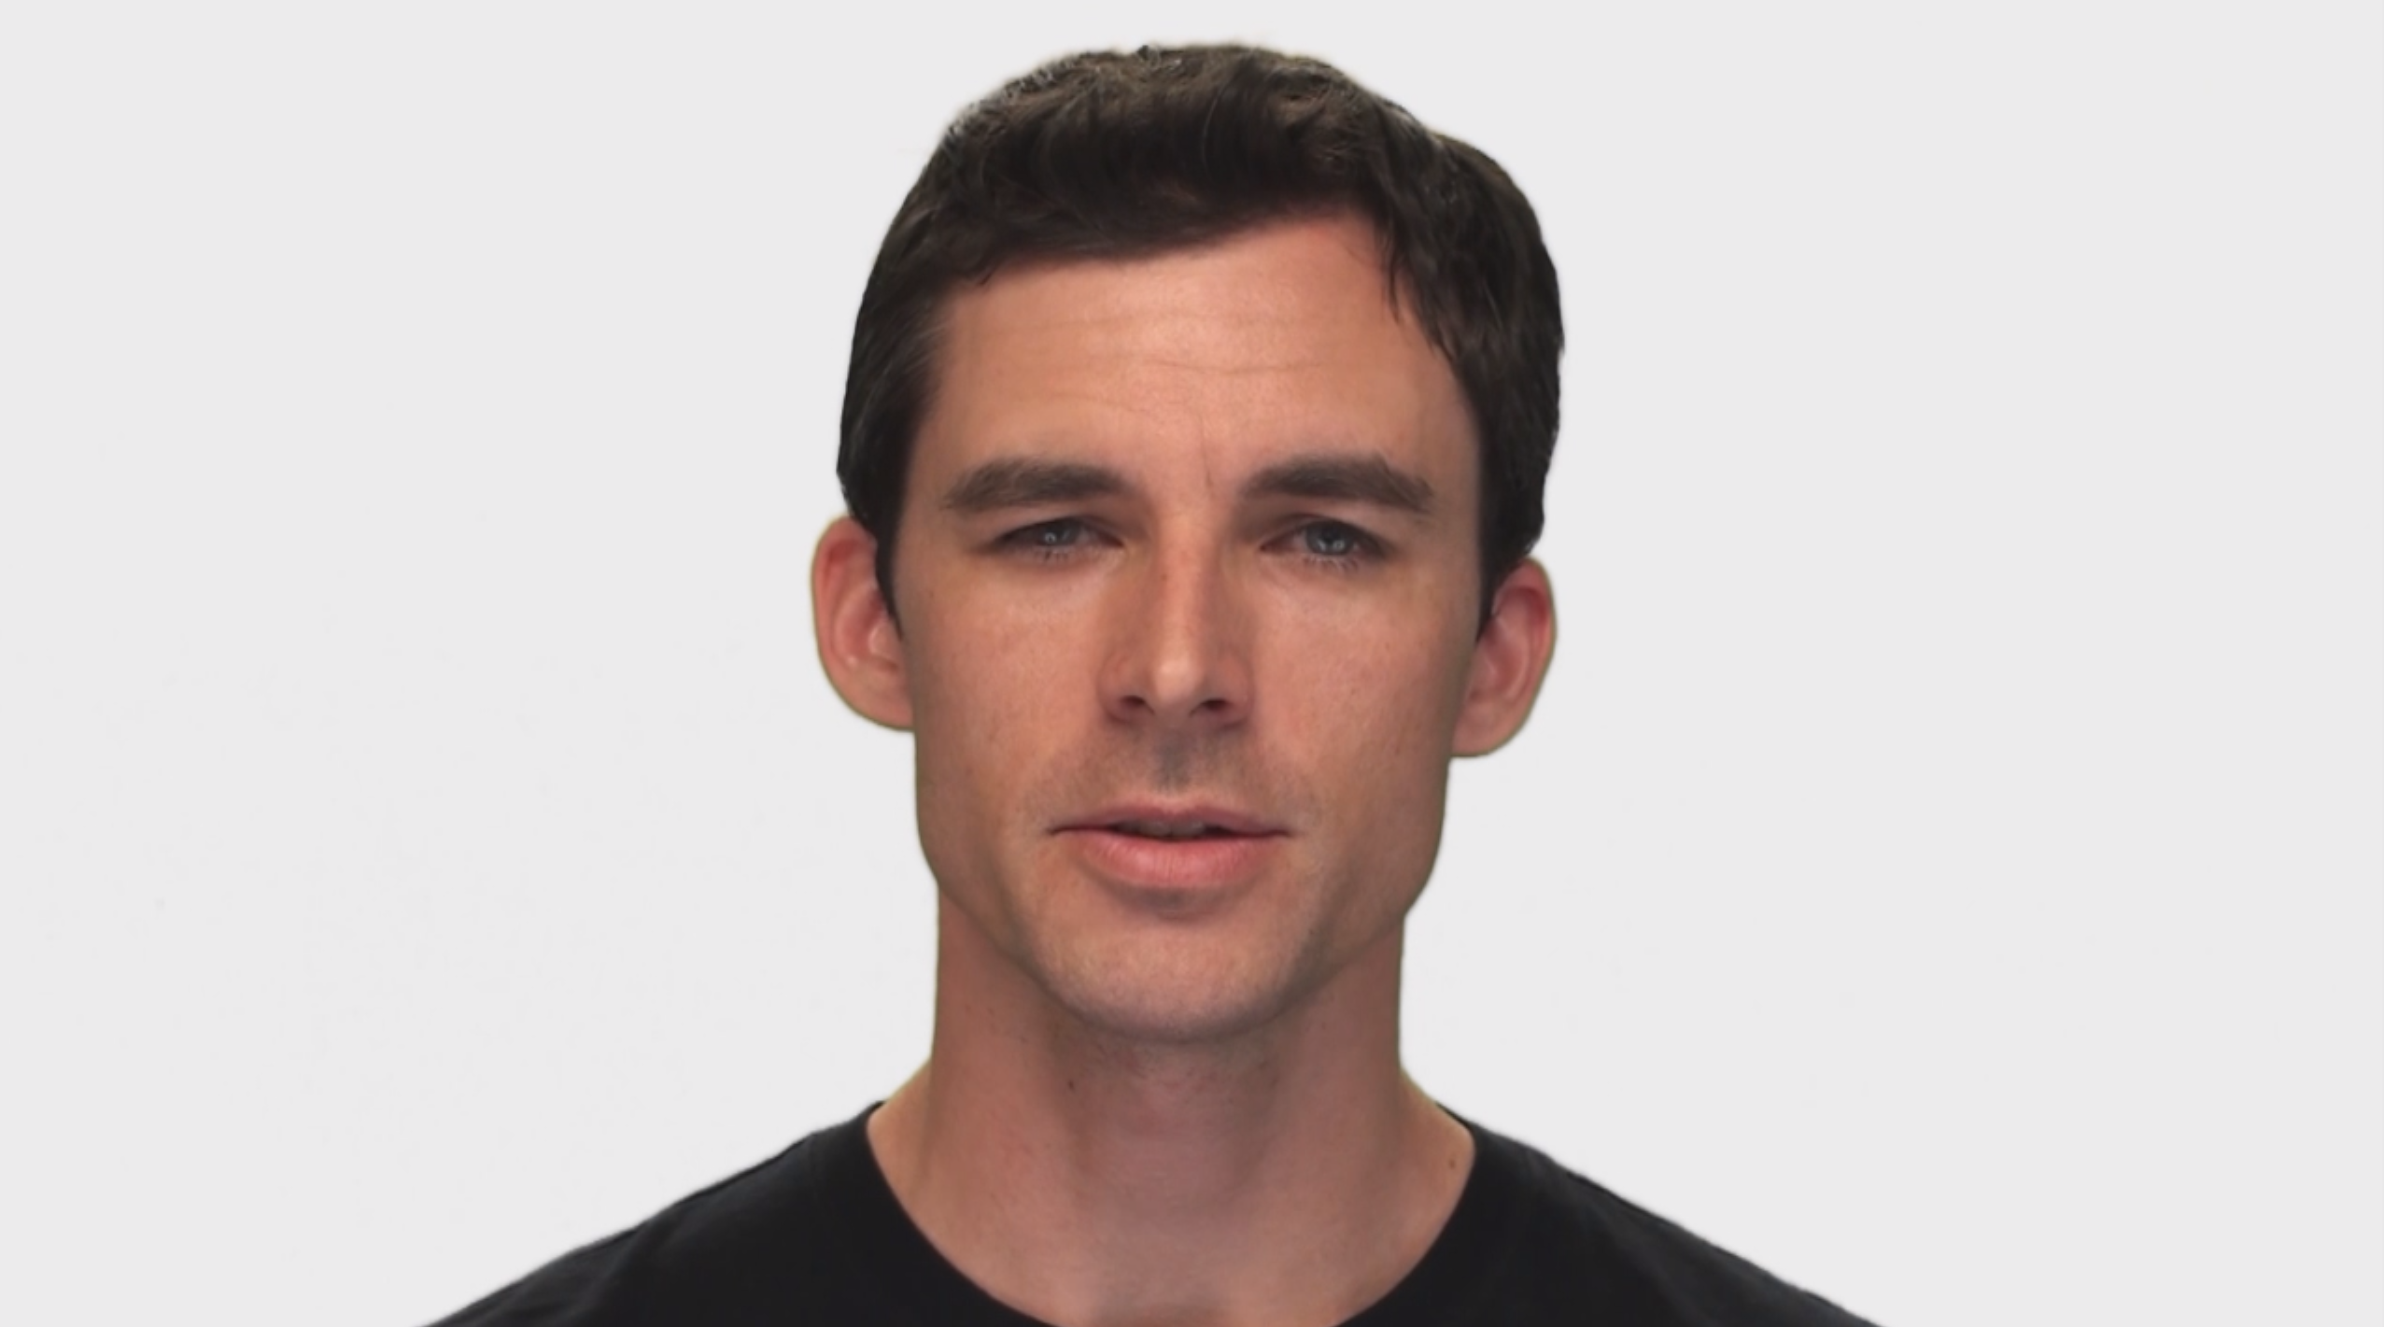
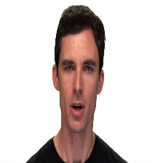
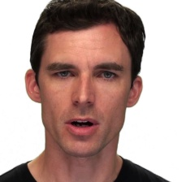
Data Preprocessing
Unzip each video file
Extract the emotion class and actor data
Read video and extract frames
Intelligent resizing
Resize to shorter size (256 by 256) + CenterCrop(224 by 224)
Extracting 16 frames from each video in the dataset
Input Frame
Naive resizing
Intelligent resizing

Slide 8
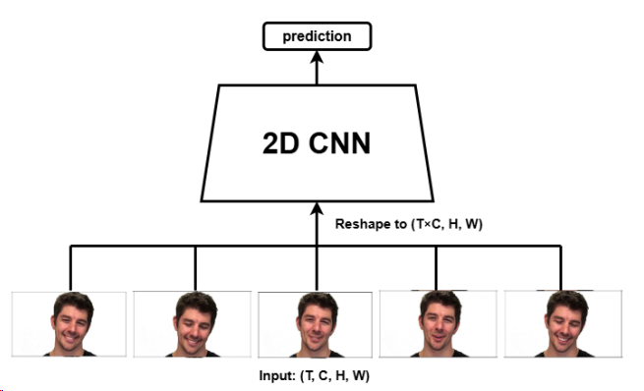
Early Fusion Model
Reshape 4D input to 3D by merging T and C → use 2D CNN
Simple architecture, quick to train
Captures very shallow temporal features
Performs moderately on accuracy
Used as baseline

Slide 9
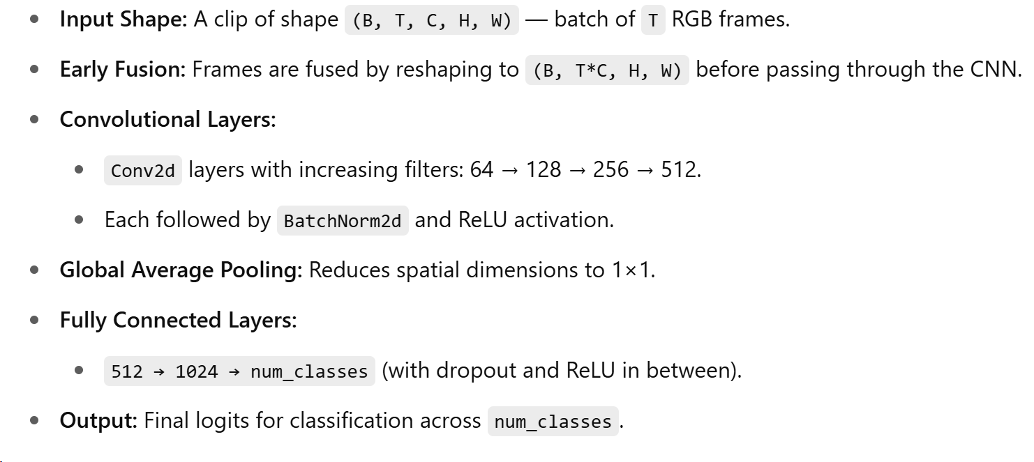
Early Fusion Model Architecture 1 (2d CNN, not pretrained)

Slide 10
Early Fusion Model Architecture 1 (2d CNN, not pretrained) [Results]
Table: Test accuracy of the early fusion model (2d CNN)
Frames | 6 | 10 | 16
No Augment | 16.67% | 21.67% | 21.67%
Augment | 28.33% | 26.67% | 28.33%

Slide 11
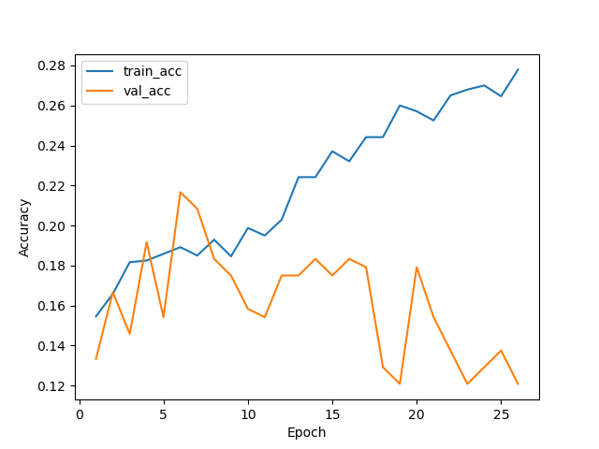
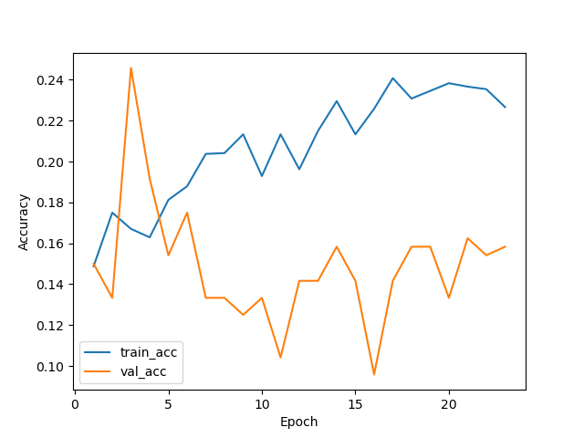
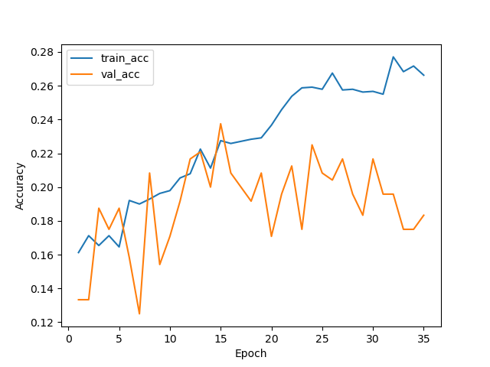
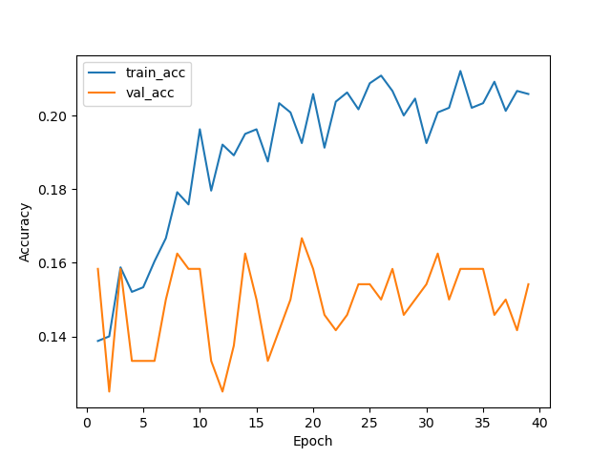
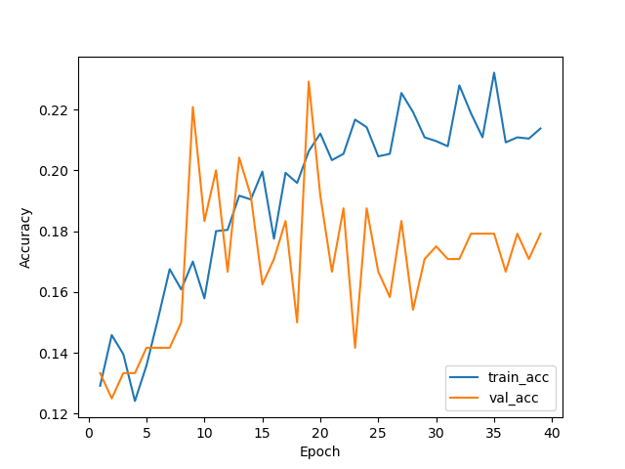
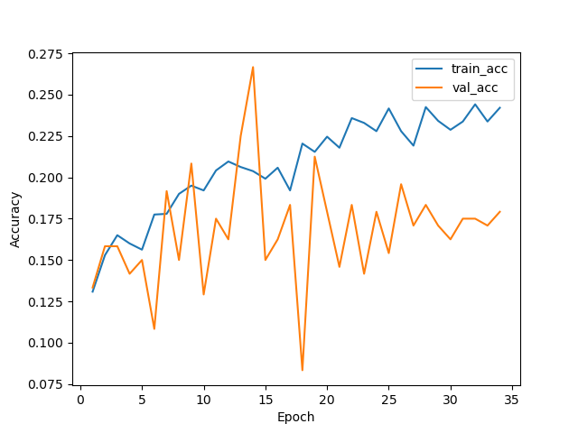
Early Fusion Model Architecture 1 (2d CNN, not pretrained) [Results]
Frames 6
Frames 10
Frames 16
No Augment
Augment

Slide 12
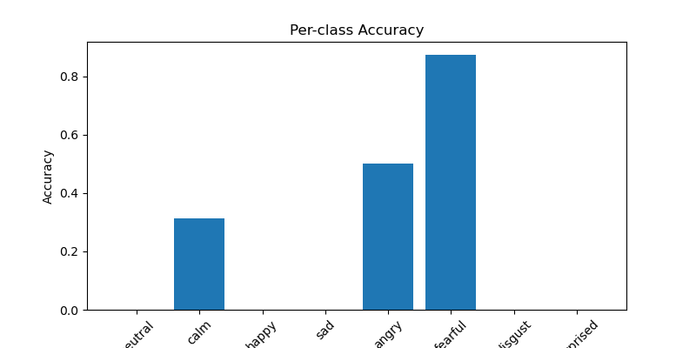
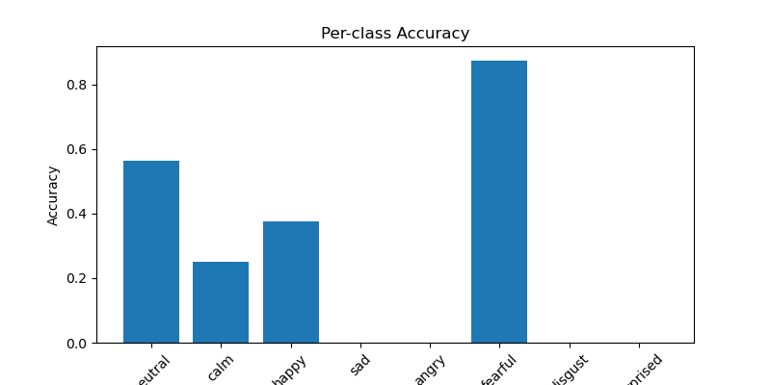
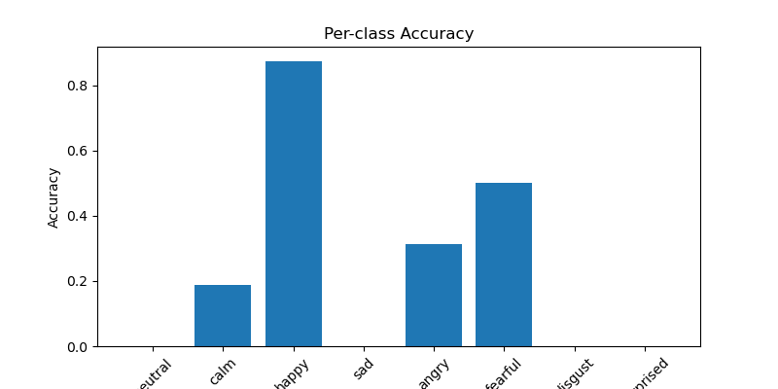
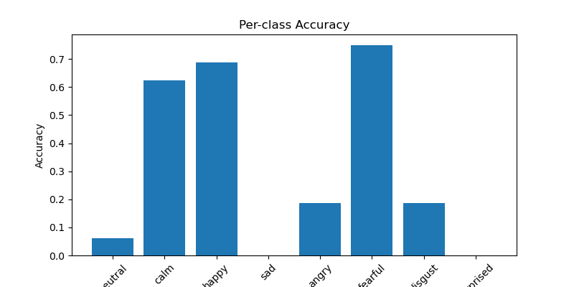
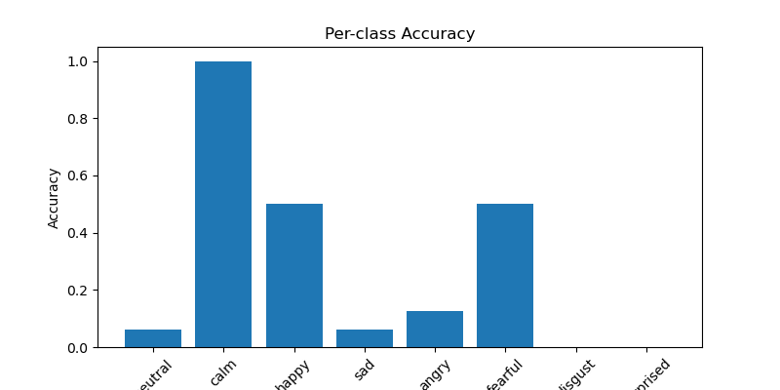
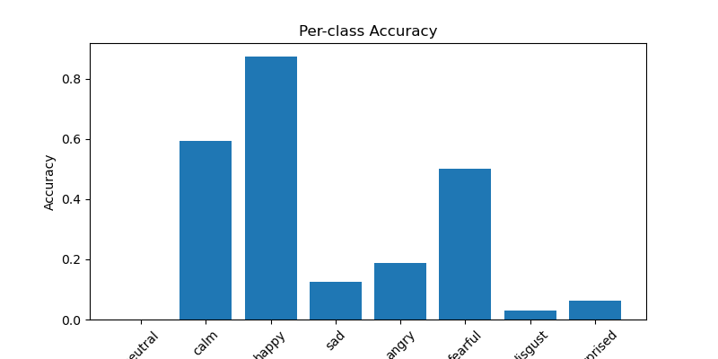
Early Fusion Model Architecture 1 (2d CNN, not pretrained) [Results]
Frames 6
Frames 10
Frames 16
No Augment
Augment

Slide 13
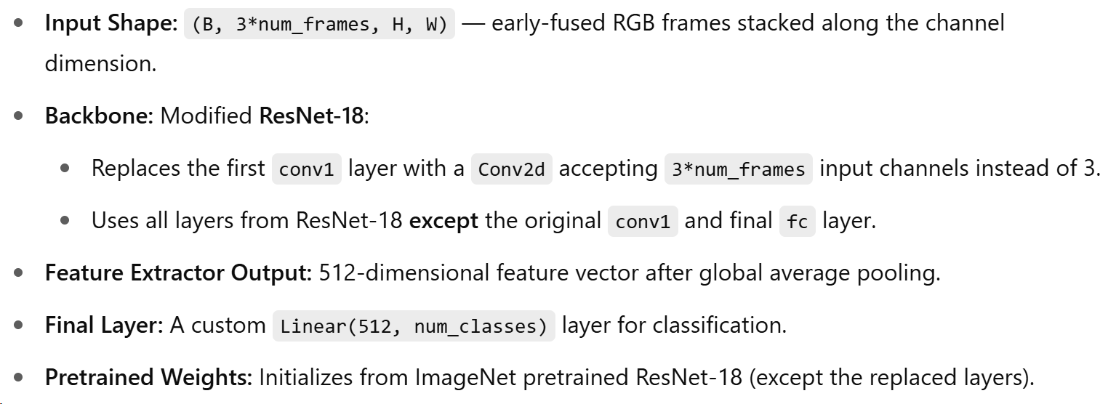
Early Fusion Model Architecture 2 (2d Resnet, pretrained)

Slide 14
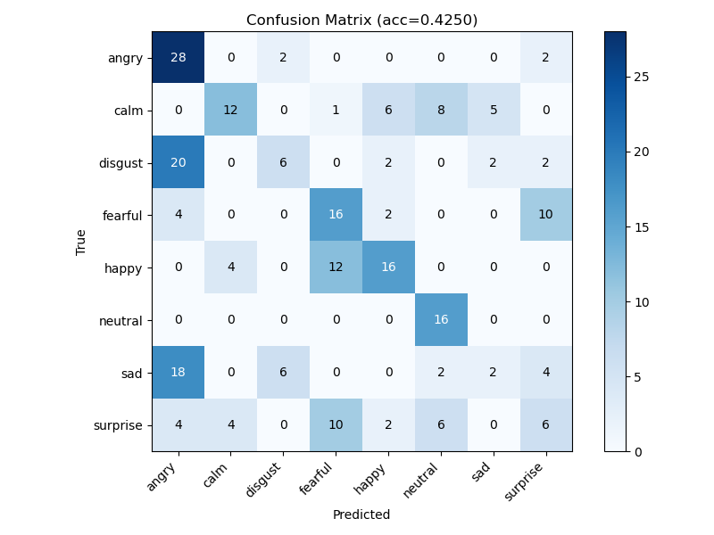
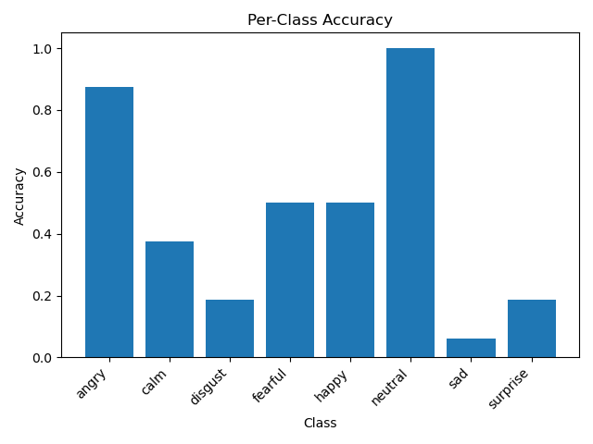
Early Fusion Model Architecture 2 (2d Resnet, pretrained) [Results]
Frames 10
Augment
Test Accuracy: 42.5%

Slide 15
Early Fusion Model Architecture 2 (2d Resnet, pretrained) [Results]
Frames 10
Augment
Test Accuracy: 42.5%

Slide 16
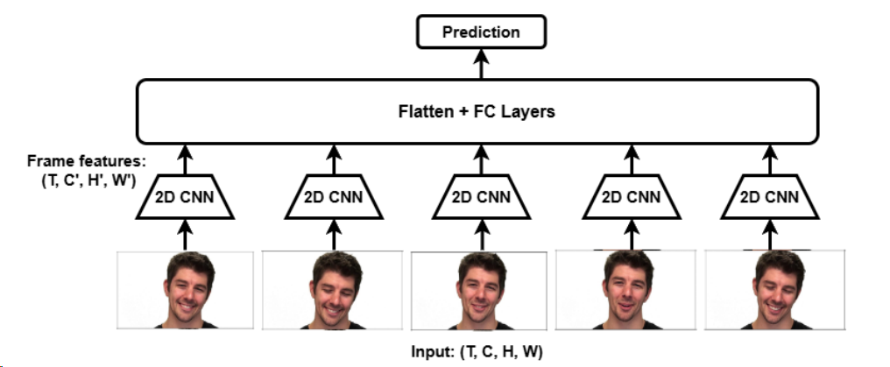
Late Fusion Model
Each frame goes through 2D CNN → feature extraction
Features concatenated and passed through FC layers
Better modeling of temporal features than early fusion
More flexible to noise or irrelevant frames
This model achieved better generalization.

Slide 17
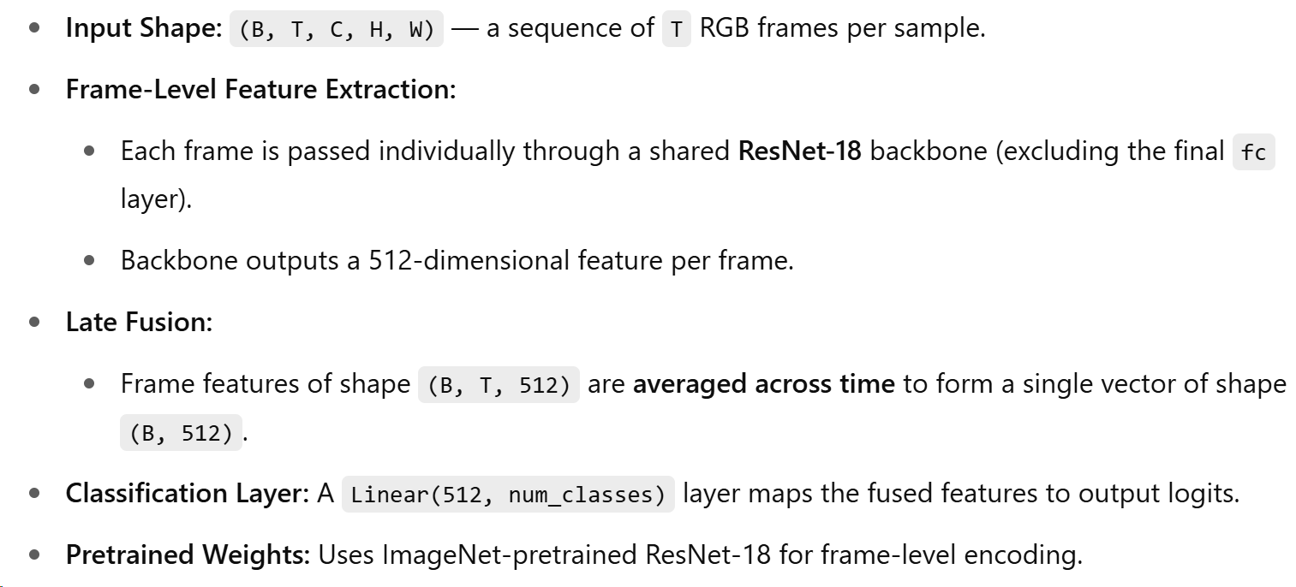
Late Fusion Model Architecture (2d Resnet, pretrained)

Slide 18
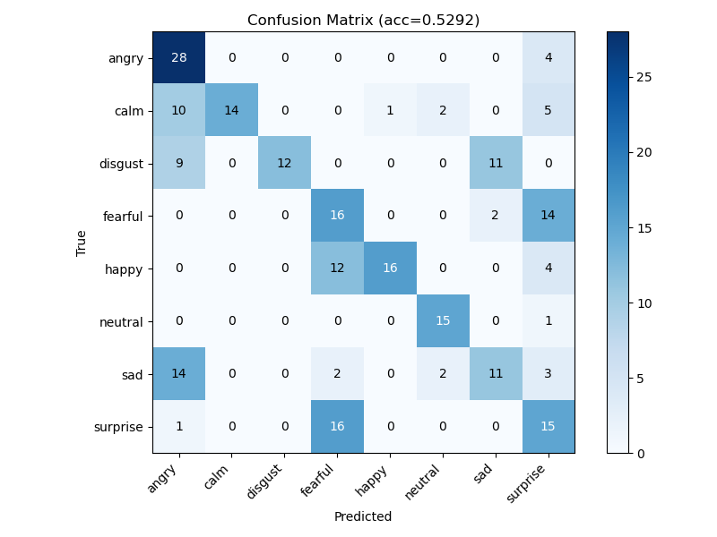
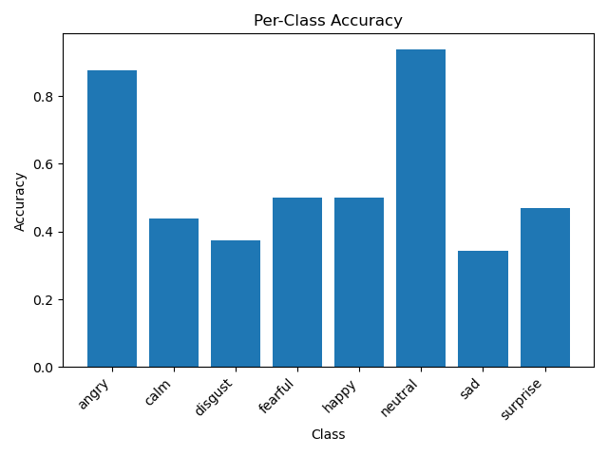
Late Fusion Model Architecture (2d Resnet, pretrained) [Results]
Frames 10
Augment
Test Accuracy: 52.9%

Slide 19
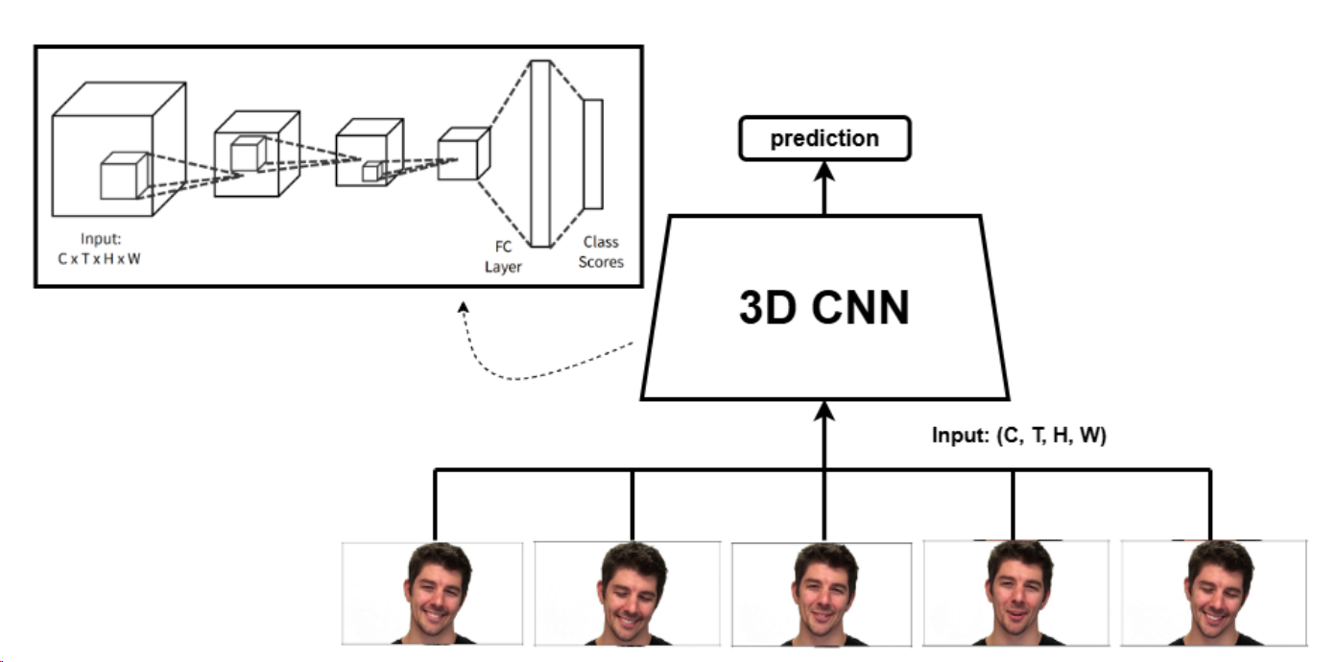
3D CNN Model
Uses 3D kernels to capture spatial & temporal features
No reshaping or frame-wise separation
Fully leverages video dynamics
Visual: 3D CNN diagram
This model outperformed better than early fusion and late fusion.

Slide 20
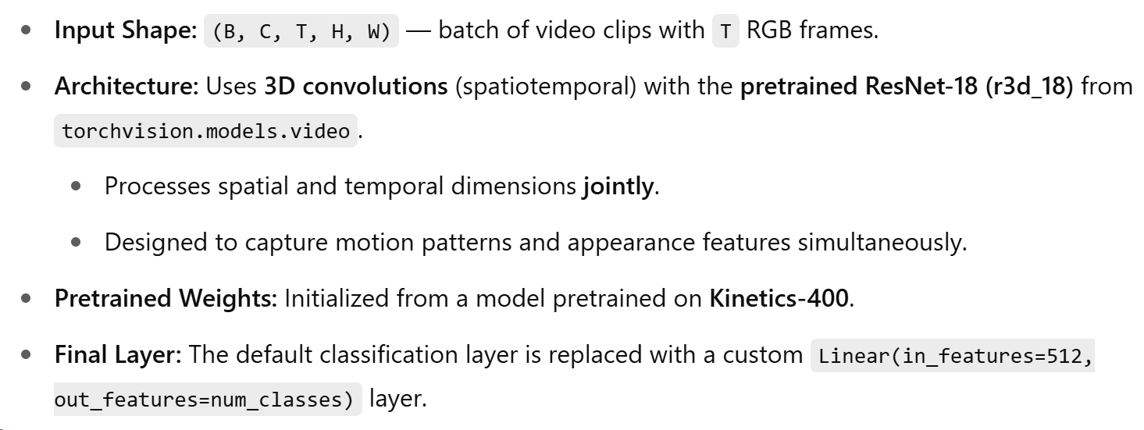
3d CNN Model Architecture (3d Resnet)

Slide 21
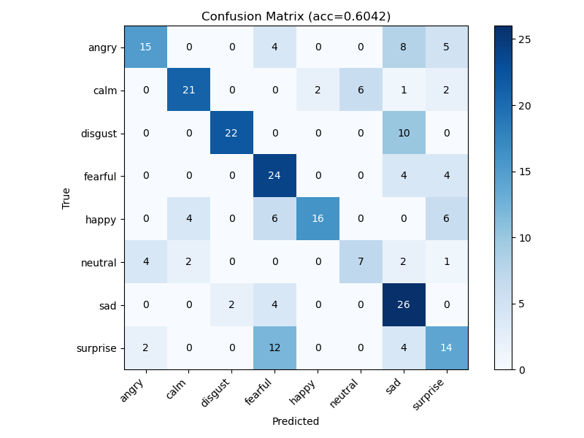
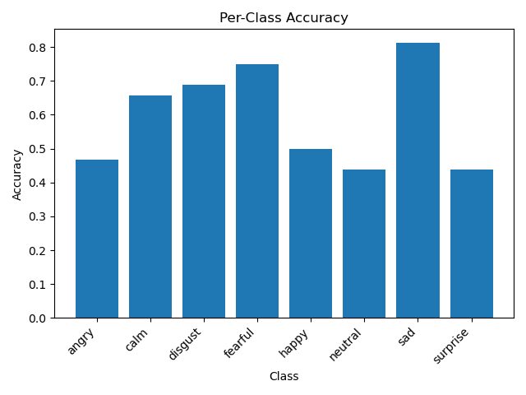
3d CNN Model Architecture (3d Resnet) [Results]
Frames 10
Augment
Test Accuracy: 60.4%

Slide 22
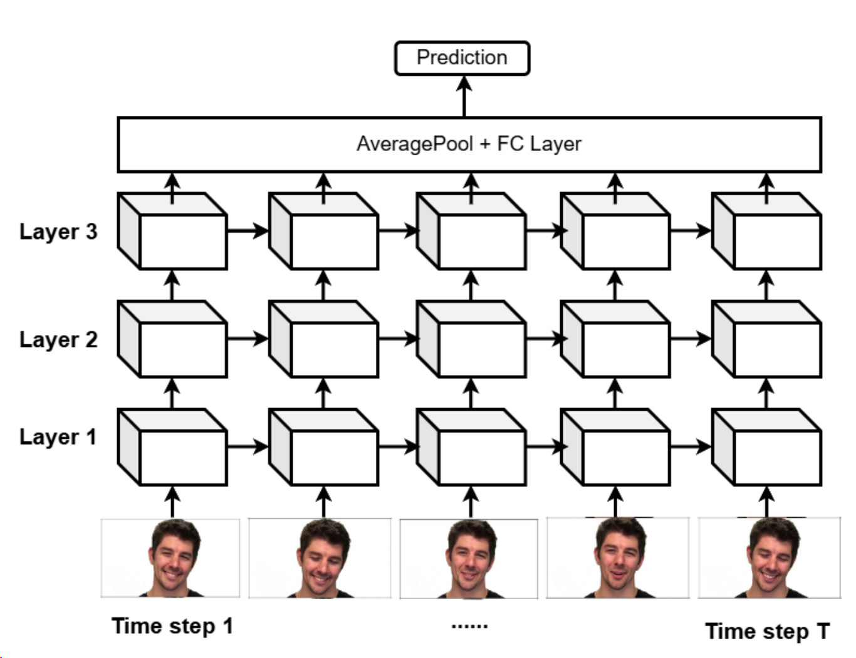
CNN-RNN Model
Uses 2D CNNs + LSTMs per layer
Takes input from previous time steps and layers
Targets long-range temporal dependencies

Slide 23
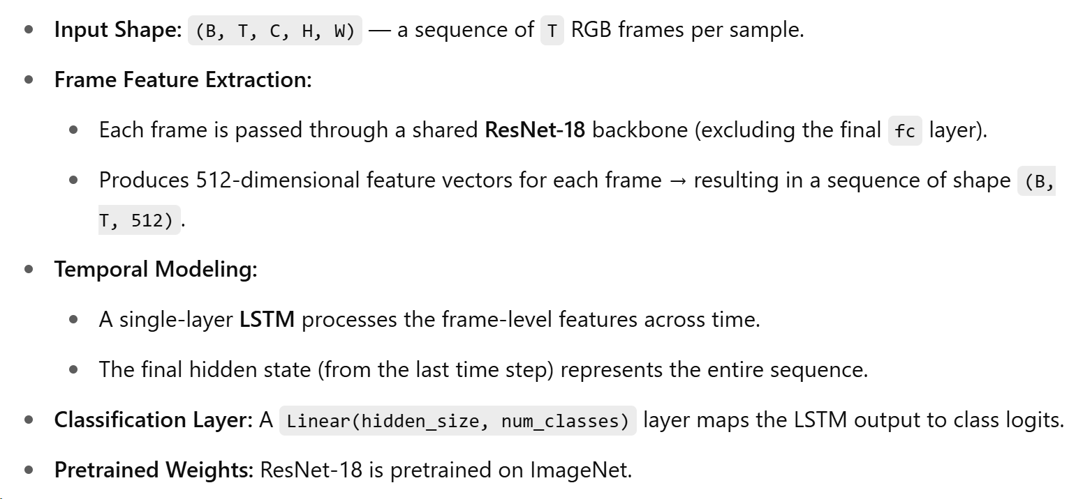
CNN (Resnet) - RNN (LSTM) Model Architecture

Slide 24
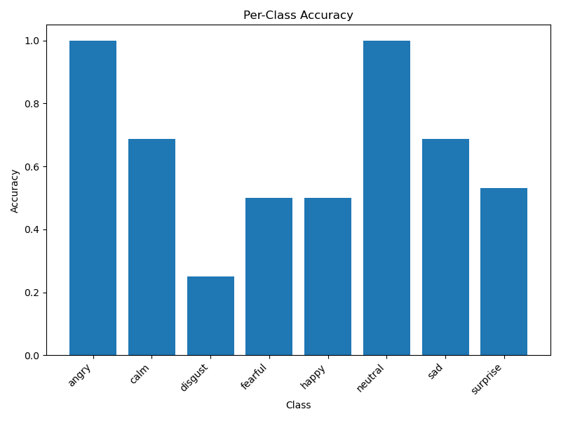
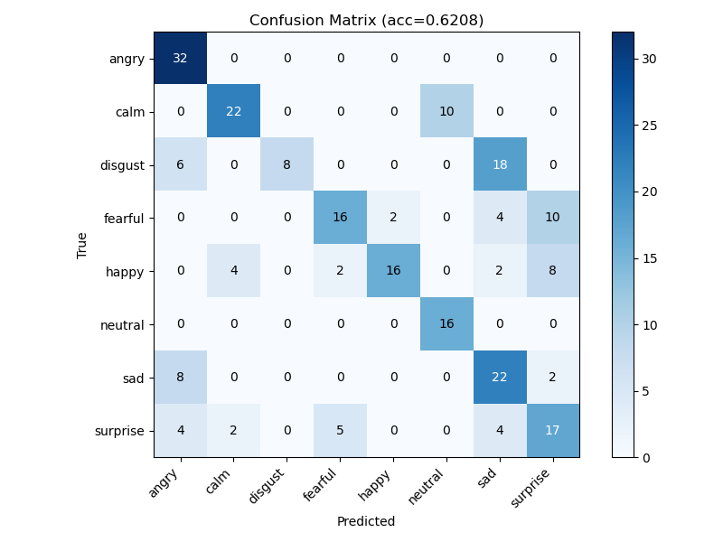
CNN (Resnet) - RNN (LSTM) Model Architecture [Results]
Frames 10
Augment
Test Accuracy: 62.08%

Slide 25
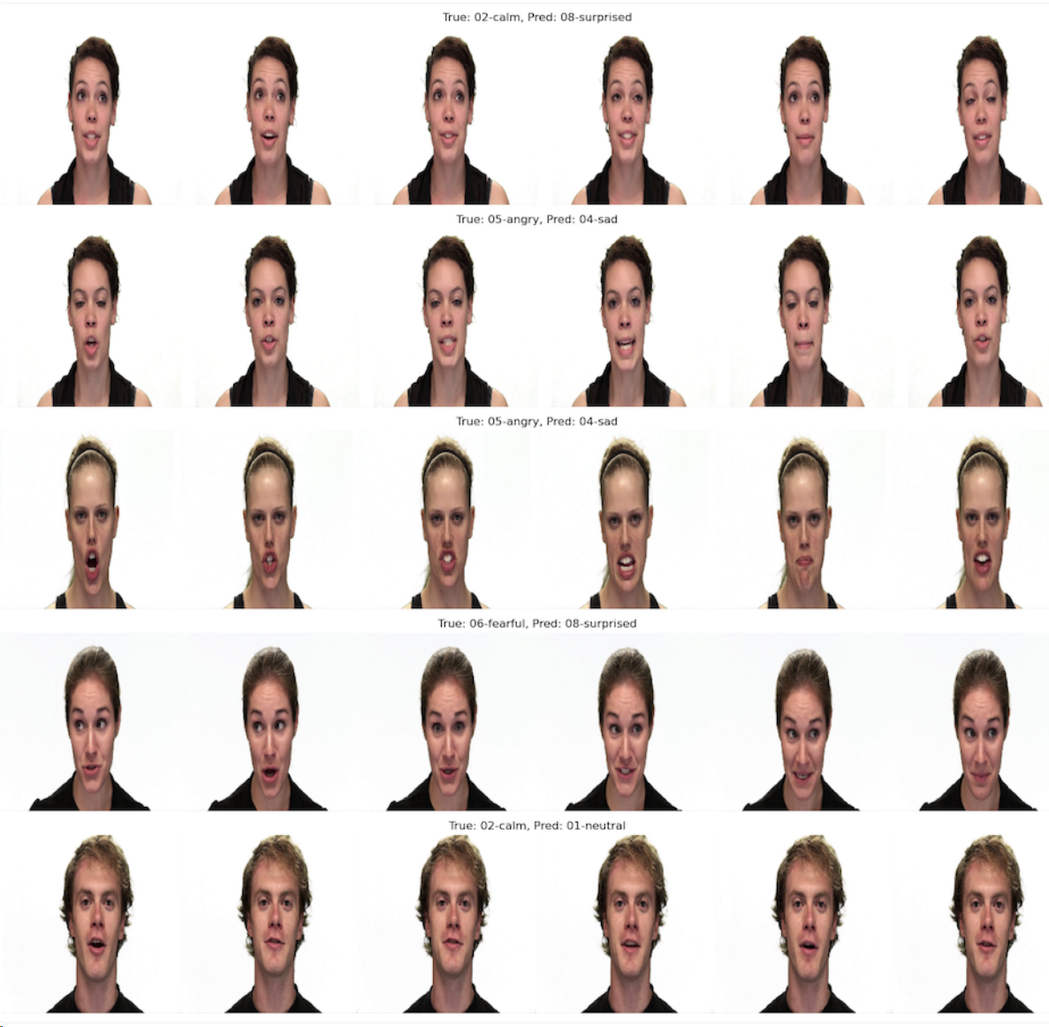
Misclassified Classes

Slide 26
Results Comparison
Table: Comparison of the best accuracies of the models
Model | Accuracy (Frames 10)
Early Fusion Model Architecture 2 (2d Resnet, pretrained) | 42.5%
Late Fusion Model Architecture (2d Resnet, pretrained) | 52.9%
3d CNN Model Architecture (3d Resnet) | 60.4%
CNN (Resnet) - RNN (LSTM) | 62.08%

Slide 27
Conclusion
CNN-RNN or 3d CNN model is best for emotion recognition in videos
Downsizing images helps both speed and accuracy
Sampling more frames gives better representation

Slide 28
Questions?

